Slide 1



Restaurant Analysis
View in Power BI
Last data refresh:
5/31/2022 11:54:12 AM UTC
Downloaded at:
5/31/2022 11:56:54 AM UTC

Slide 2
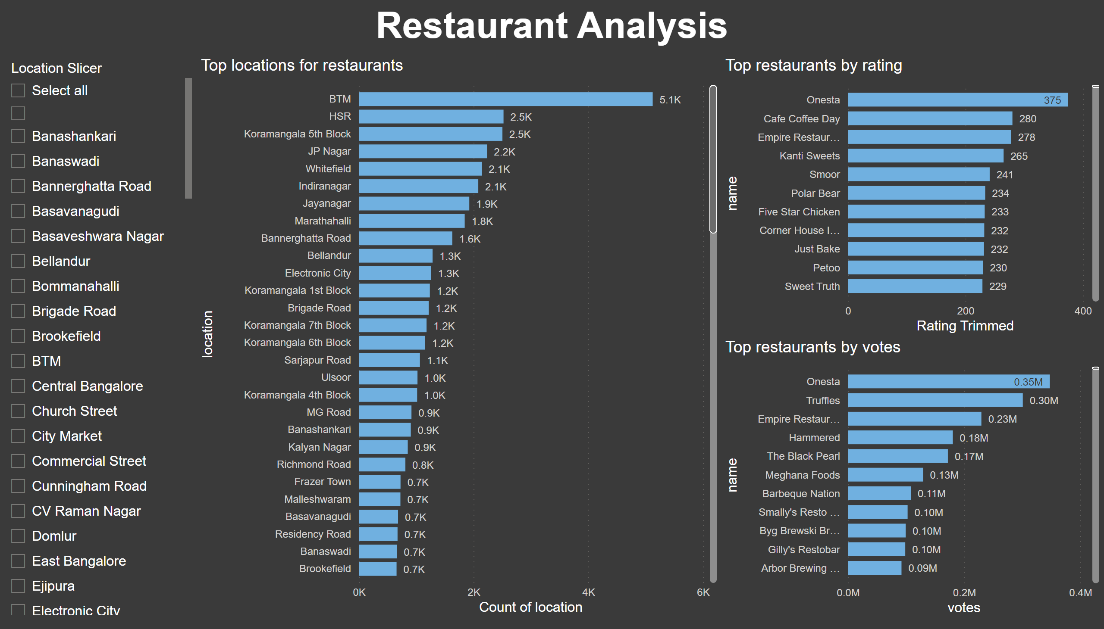
Part 1
Notes:
Top locations for restaurants
No alt text provided
textbox
No alt text provided
slicer
No alt text provided
Top restaurants by rating
No alt text provided
Top restaurants by votes
No alt text provided

Slide 3
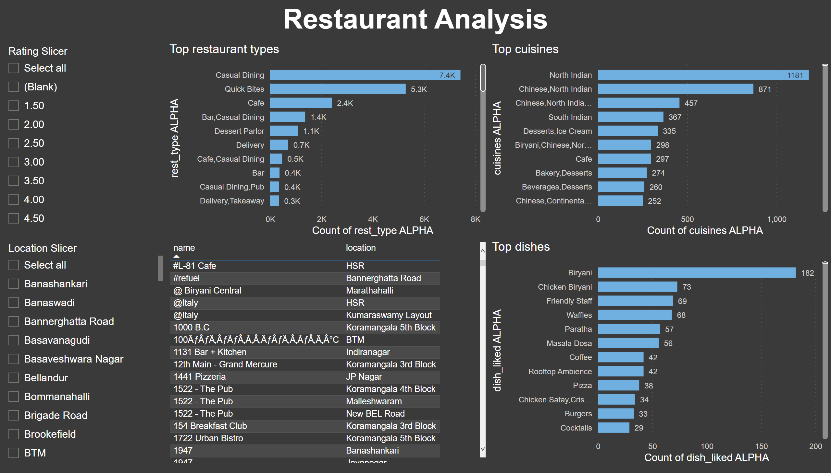
Part 2
Notes:
Top cuisines
No alt text provided
textbox
No alt text provided
Top restaurant types
No alt text provided
Top dishes
No alt text provided
slicer
No alt text provided
slicer
No alt text provided
tableEx
No alt text provided

Slide 4
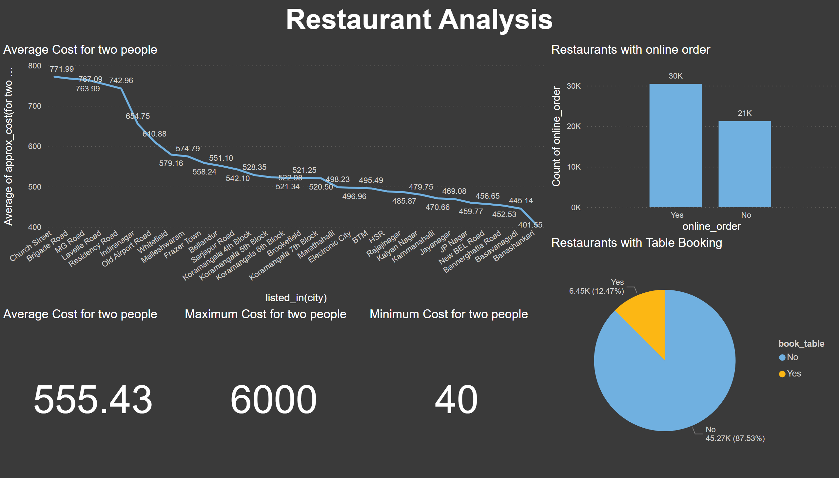
Part 3
Notes:
textbox
No alt text provided
Average Cost for two people
No alt text provided
Average Cost for two people
No alt text provided
Restaurants with online order
No alt text provided
Restaurants with Table Booking
No alt text provided
Maximum Cost for two people
No alt text provided
Minimum Cost for two people
No alt text provided

Slide 5
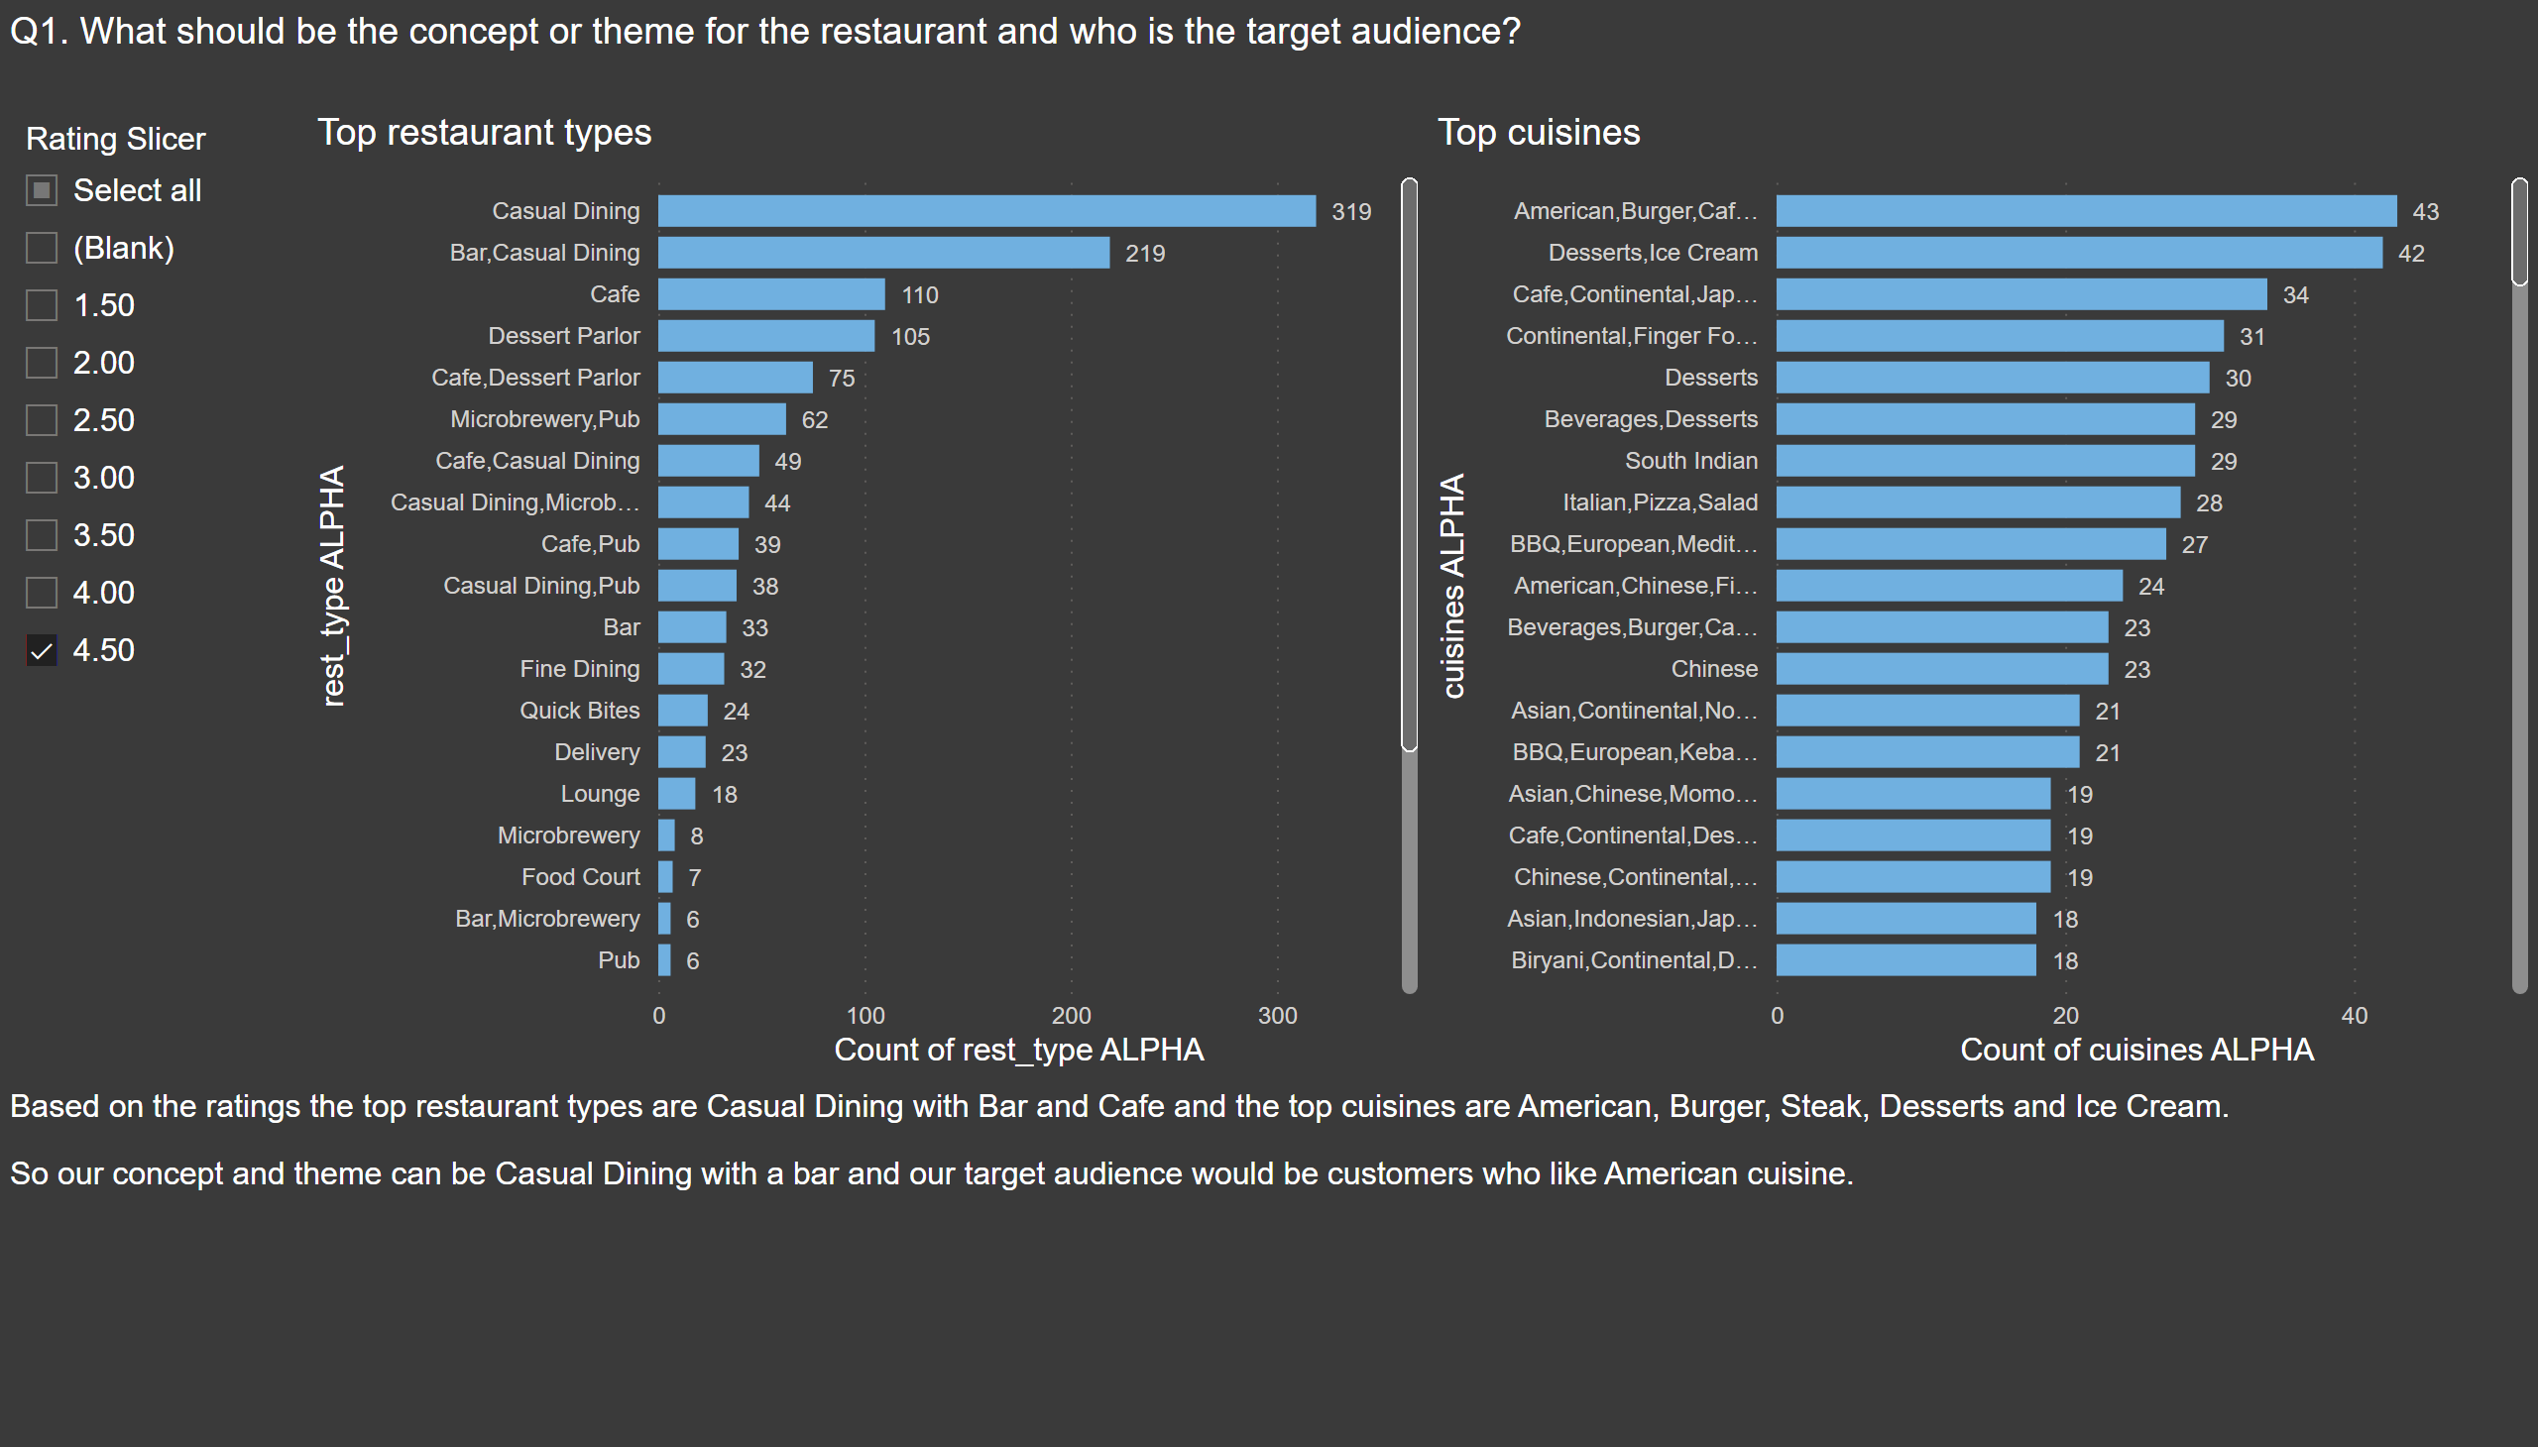
Q1
Notes:
textbox
No alt text provided
Top restaurant types
No alt text provided
Top cuisines
No alt text provided
textbox
No alt text provided
slicer
No alt text provided

Slide 6
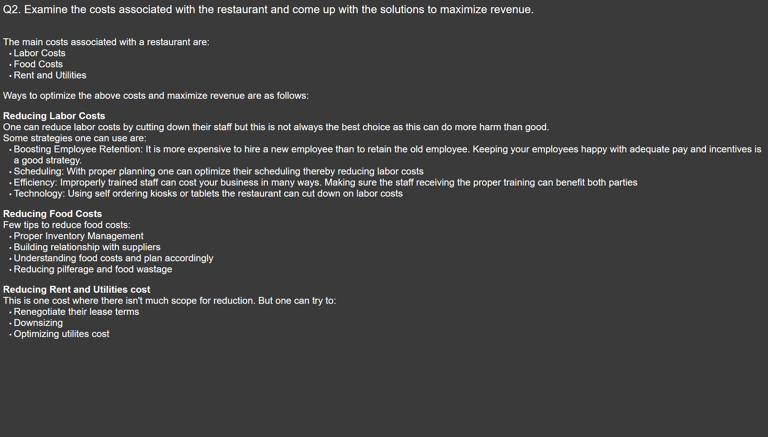
Q2
Notes:
textbox
No alt text provided
textbox
No alt text provided

Slide 7
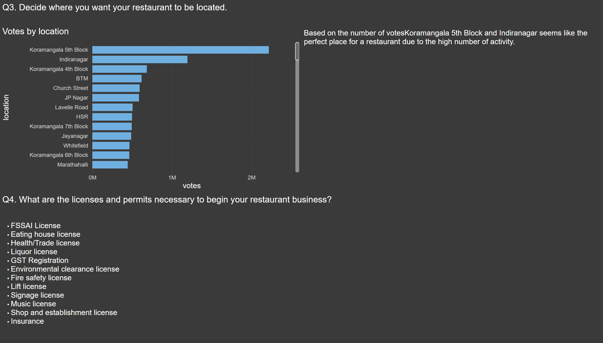
Q3 & Q4
Notes:
textbox
No alt text provided
textbox
No alt text provided
Votes by location
No alt text provided
textbox
No alt text provided
textbox
No alt text provided

Slide 8
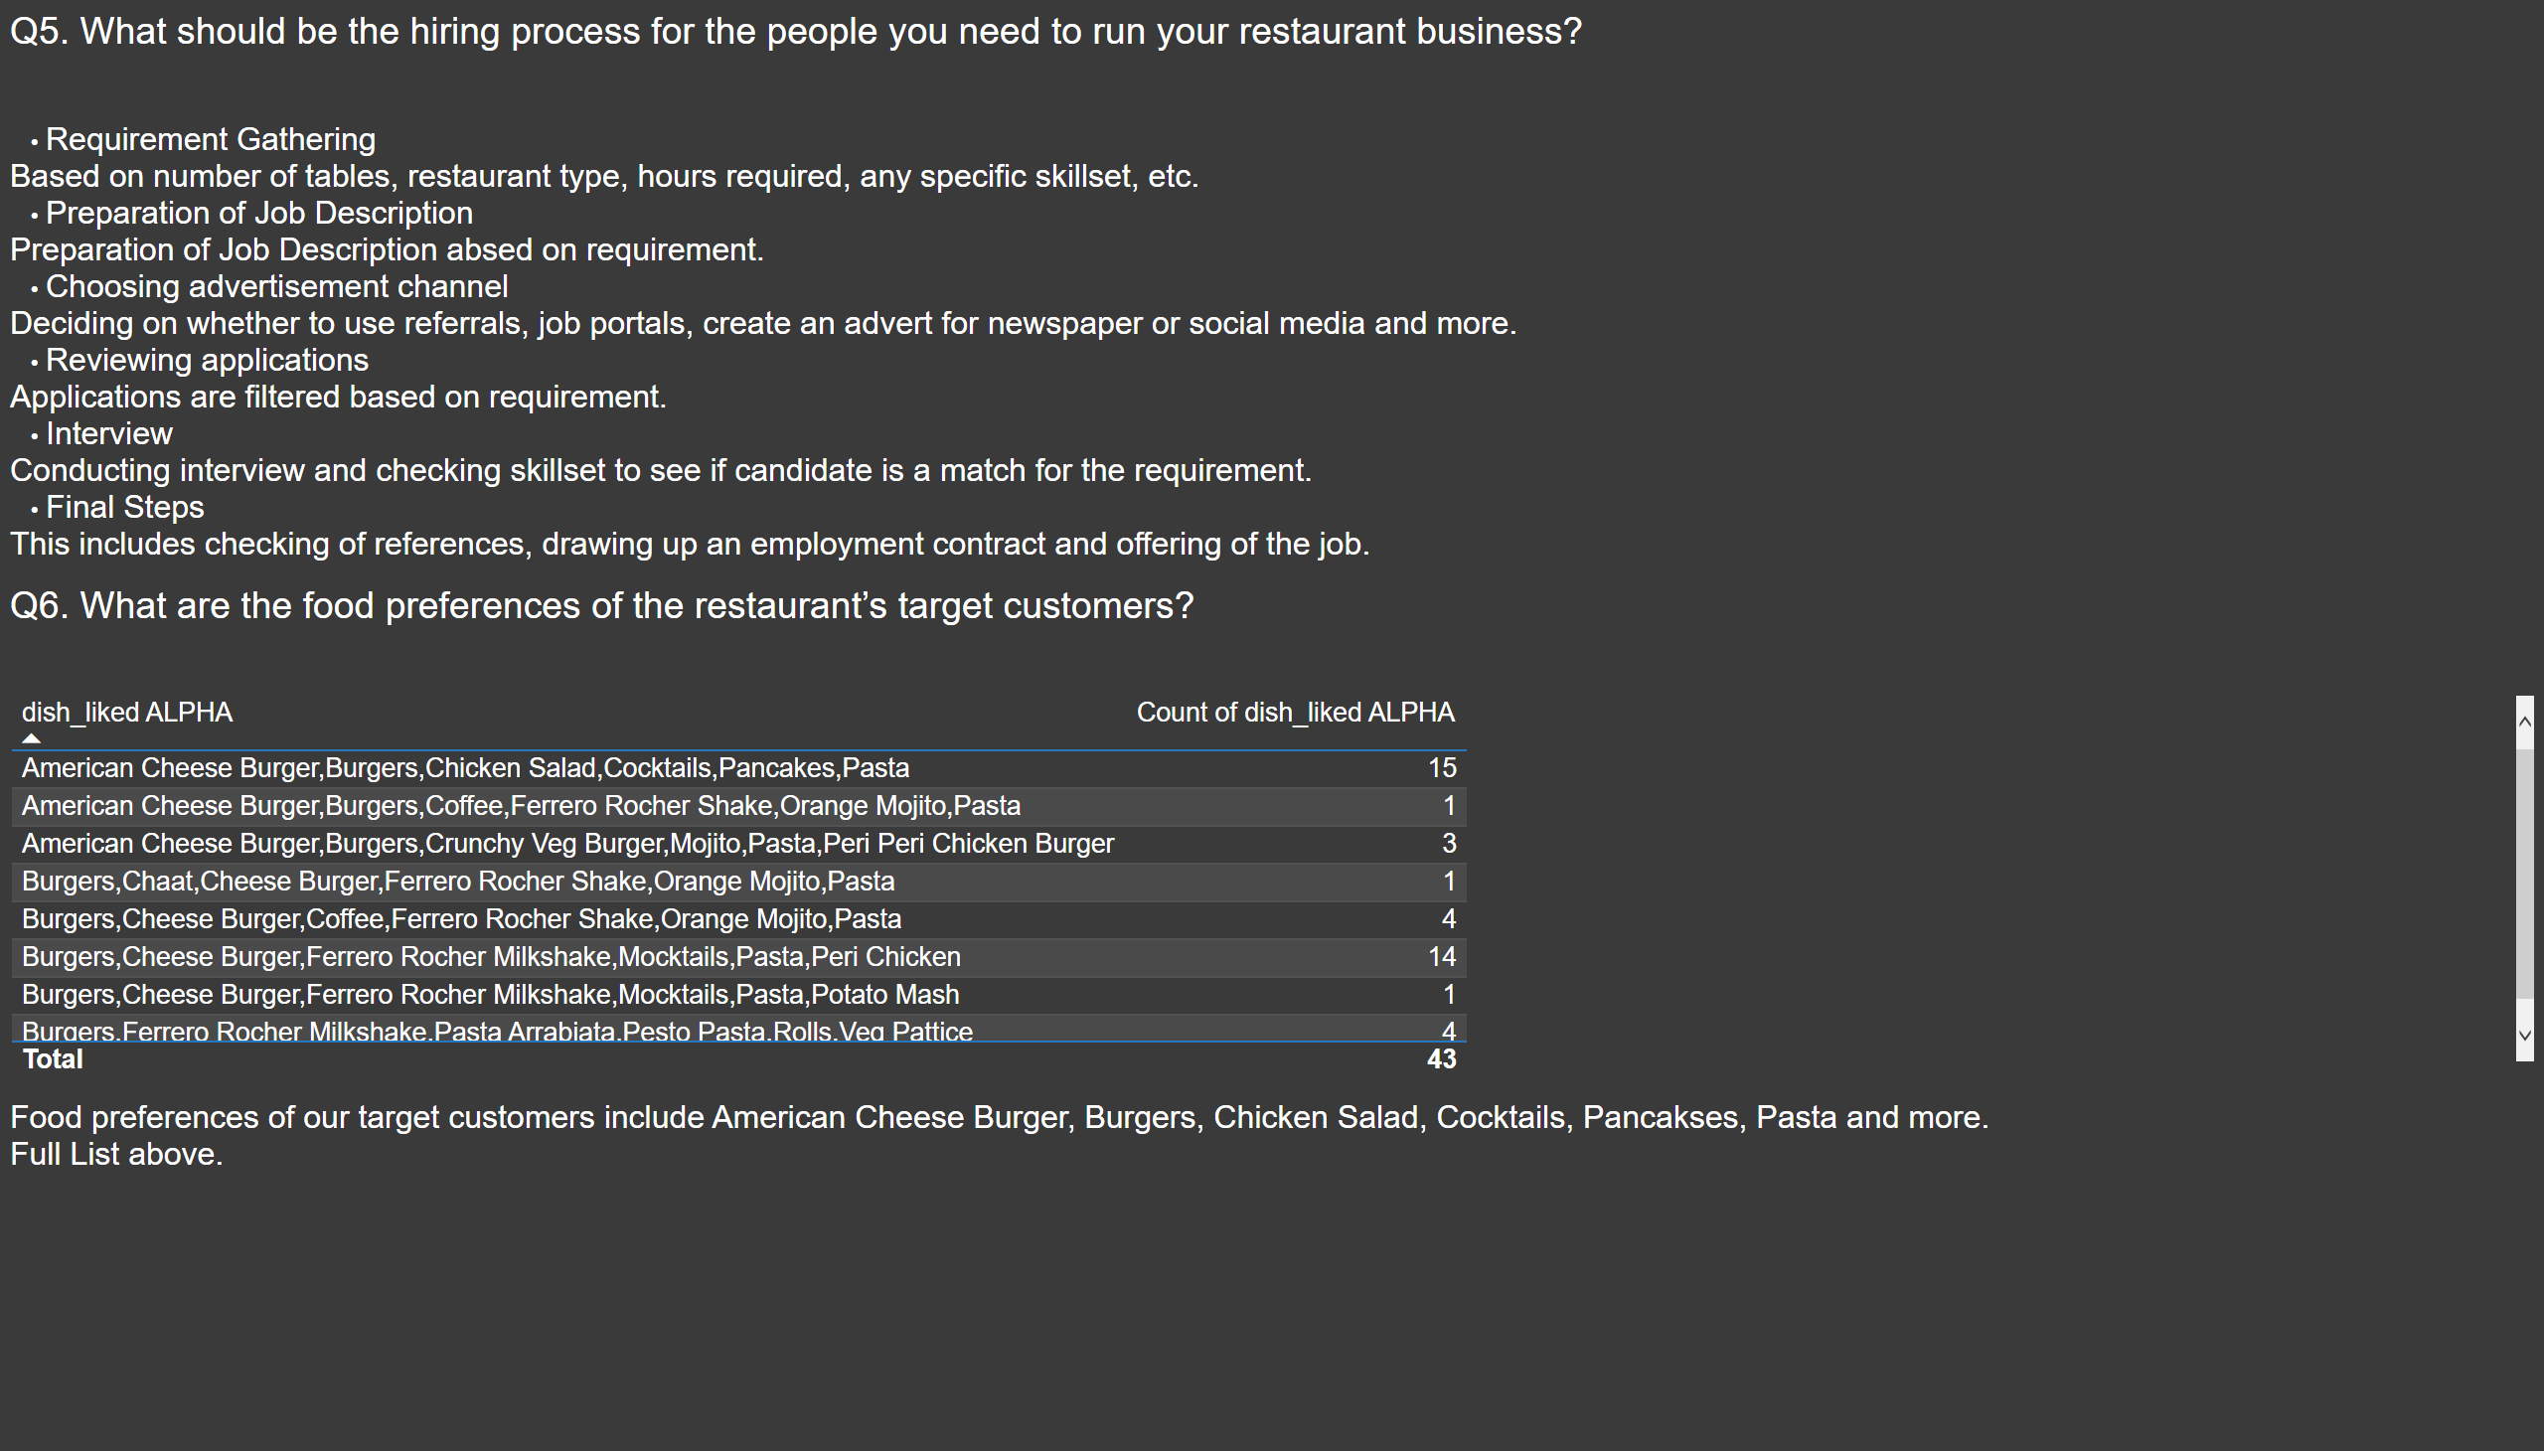
Q5 & Q6
Notes:
textbox
No alt text provided
textbox
No alt text provided
textbox
No alt text provided
textbox
No alt text provided
Top dishes
No alt text provided

Slide 9
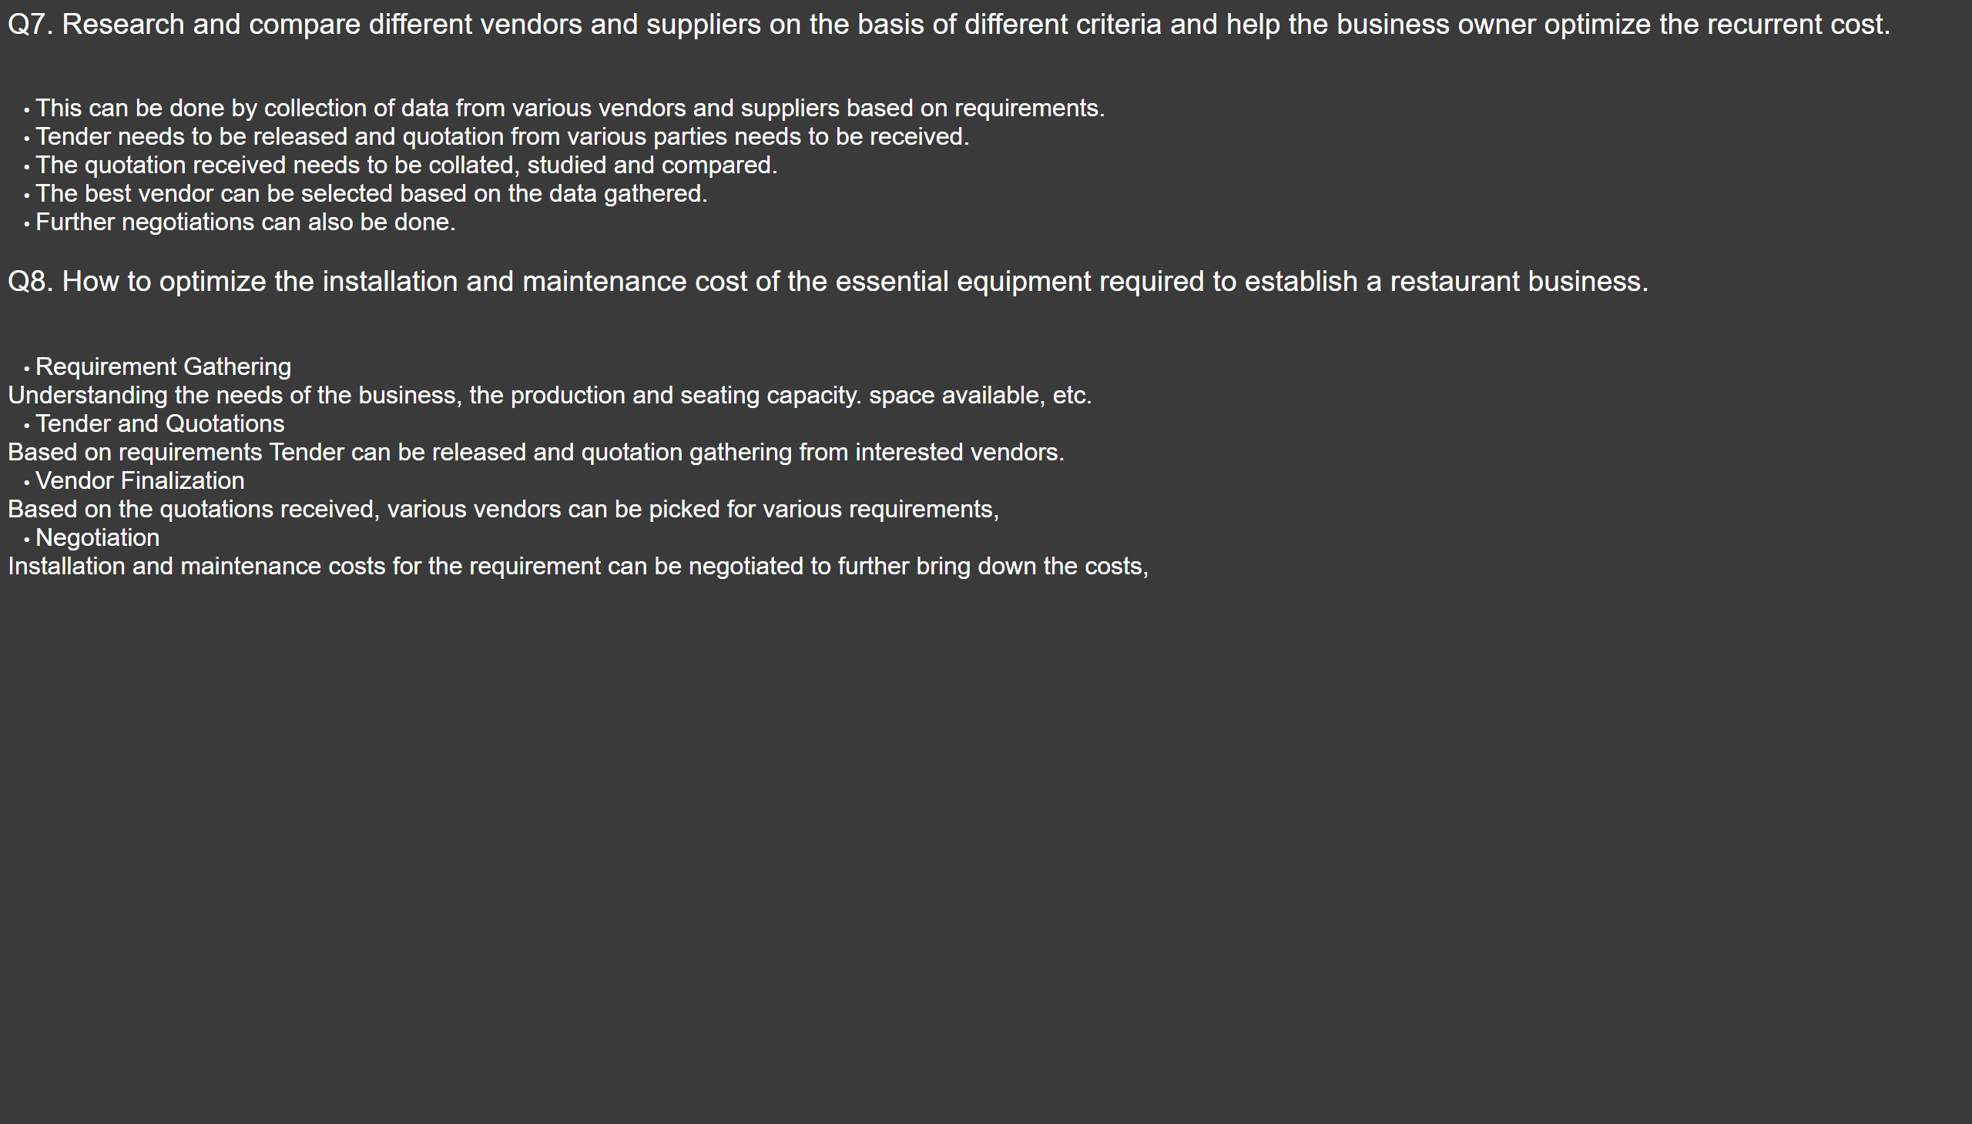
Q7 & Q8
Notes:
textbox
No alt text provided
textbox
No alt text provided
textbox
No alt text provided
textbox
No alt text provided

